Slide 1
Week 2
How to think about and use data

Slide 2
Data, what's the point?
Data can be used by people or companies to make choices about their behaviors in the future, or to look back on what choices they've made
Even things like budgets are based on data you've collected even if you didn't realize it (going back through previous bills is data collection)
The better we can understand and collect our data, the better our choices can be
The better our data the more accurate our predictions and past trends will be

Slide 3
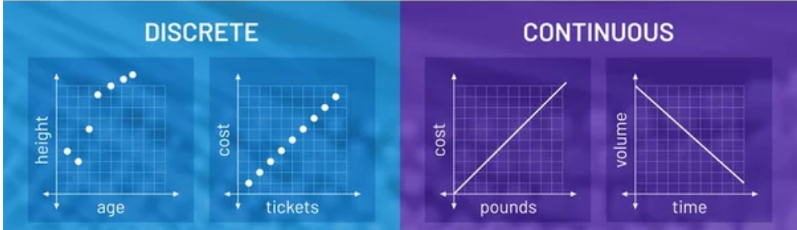
How to think about data
Why we gather data
Data can be used in a variety of applications from predicting what a store should stock based on previous sales, to what the weather could be like next week
Is your data discrete or continuous
How should your data be organized in general?
Group books by Genre? Or Trope? Recommended age range?
For example, Don't have a column "Money" when you could split out sales and profits.

Slide 4
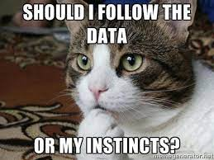
Data and problem solving
First steps are to define the problem and outline your process to solve
Make sure to include what a "success" means!
Collect and structure your data
Visualize and analyze your data
Decide how the data can change your next steps

Slide 5
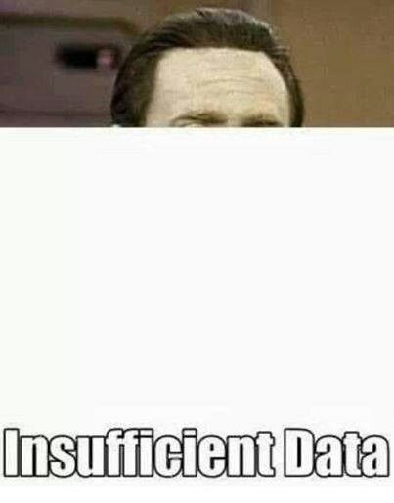
Collect your data
Data can be collected
Manually (take temp of day every hour)
Automatically (take temp through sensor every second
When data is collected, it's important to pay attention to the form
Celsius vs Fahrenheit, or meters vs feet
Make sure to collect the same data (if it's books, collect title AND author not OR)
Data accuracy is important! Don't fudge or make things up. Blank is better than inaccurate
Measure all data in the same way (if you use a ruler make sure you are consistent with where you consider the "start")

Slide 6
Structure your data
Make sure it's in the same order so you don't have confusion of things like title vs author vs editor
If data is starting in something like a spreadsheet, rows vs columns is important!
Data labels are important, make sure each row, column or other is clearly labeled
You may want to specify the type of data expected, such as text, or single char, or integer, or float.

Slide 7
Analyze your data
Data analysis is where we collect, process, define, and clean our data so that we can finally do something with it
Data analysis can be done visually by a human to see trends, or with large computer programs if our data set is too big for a person (most common)
The type of analysis we do will depend on the data
Numbers might use a statistical analysis, and would should trends like less books borrowed on a Tuesday
Text analysis might show trends such as people are less satisfied with their books in January because the reviews contain more negative words

Slide 8
Visualize your data
How we can take numbers, or text, or data and present it in a way it's easier for humans to see
This can be done in graphs, or charts to show trends
Data visualization is important to make sure other people can follow what's going on in your data, BUT it can be manipulated!
Data visualizations can show anything depending on bias
Data visualizations can be good or bad, confusing or clear, depending on the choices you make
Everything from colour, to size of visual, to measurements matter!
Raw data is unlikely to be helpful when looked at

Slide 9
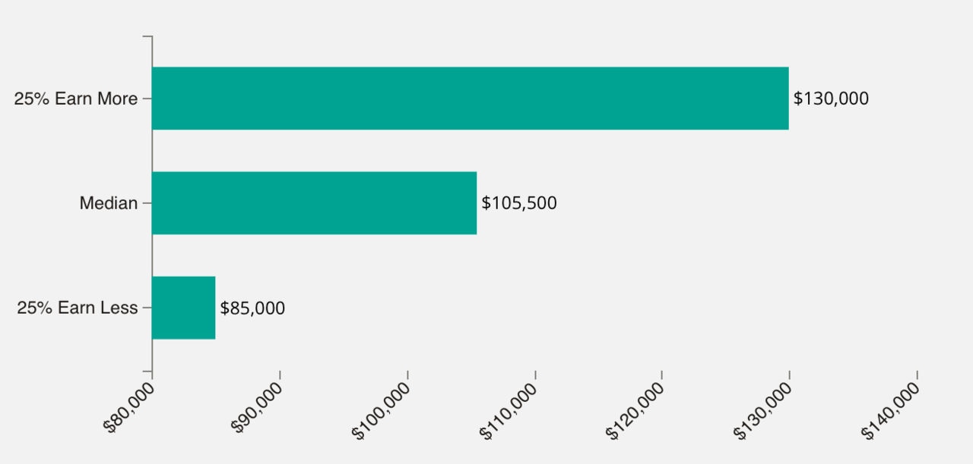
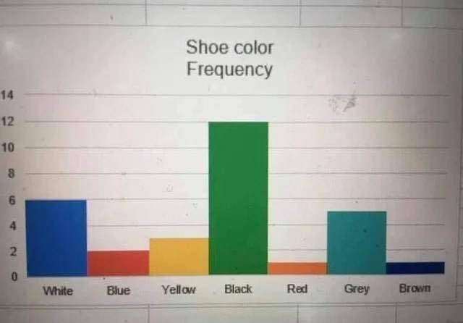
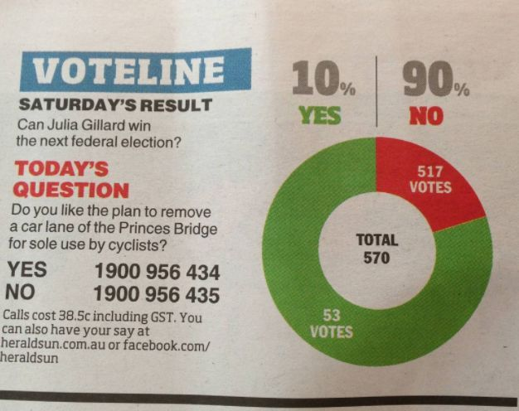
Good vs Bad visualization
Some examples of bad visualizations https://viz.wtf/

Slide 10
Decide how your data informs your next steps
What is your goal with your data?
Do you want to show sales in the month to see when you need more hours worked? More stock ordered? More employees on call? Different kinds of stock?
Is the data you've gathered and analyzed enough or do you need more? Does monthly make sense? Yearly? Daily? What's reasonable for your goal?

Slide 11
Descriptive or predictive data
Descriptive data
This is about how we describe and summarize our data
This type of data might show anomalies and past trends
Might be used to generate reports on previous behaviors or see if there is a potential correlation (such as people buy less books during wage downturns)
Predictive data
This is about what you think might happen in the future based on history
This could be predicting market trends for what to order in a store, or stock for a holiday
Might be used to try and guess what's going to happen next such as what stock we should have in a store next month

Slide 12
How to use data every day
Businesses use data every day to make choices on everything from what to stock, and what to order and what they might need to pre-order way in advance
Humans use data as well for our choices
If your kids eat grilled cheese twice a week you know how much bread you might need
If in previous holiday seasons you spent $200 on presents, you know how much to save for this holiday

